Slide 1

RUNGTA COLLEGE OF DENTAL SCIENCES & RESEARCH
TITLE OF THE TOPIC-
FUNCTIONS OF STOMATOGNATHIC SYSTEM
DEPARTMENT OF ORTHODONTICS AND DENTOFACIAL ORTHOPAEDICS

Slide 2
Specific learning Objectives
CORE AREAS | DOMAIN | CATEGORY
FUNCTIONS OF STOMATOGNATHIC SYSTEM | AFFECTIVE | DESIRE TO KNOW
MASTICATION | PSYCHOMOTOR | NICE TO KNOW
DEGLUTITION | PSYCHOMOTOR | MUST KNOW
SPEECH | AFFECTIVE | MUST KNOW
RESPIRATION | PSYCHOMOTOR | MUST KNOW

Slide 3
CONTENTS
Functions of stomatognathic system
Mastication
Chewing stokes
Opening phase
Closing phase
Tooth contacts during mastication
Increased bite force
Role of soft tissues in mastication
Deglutition
Definition
Types of swallow
Stages of swallow

Slide 4
Continued…..
Frequency of swallowing
Conditions associated with swallowing
Speech
Definition
Factors affecting speech
Process involved in speech production and organization
Respiration
Definition
Types of respiration
Characteristics of normal respiration
Summary

Slide 5
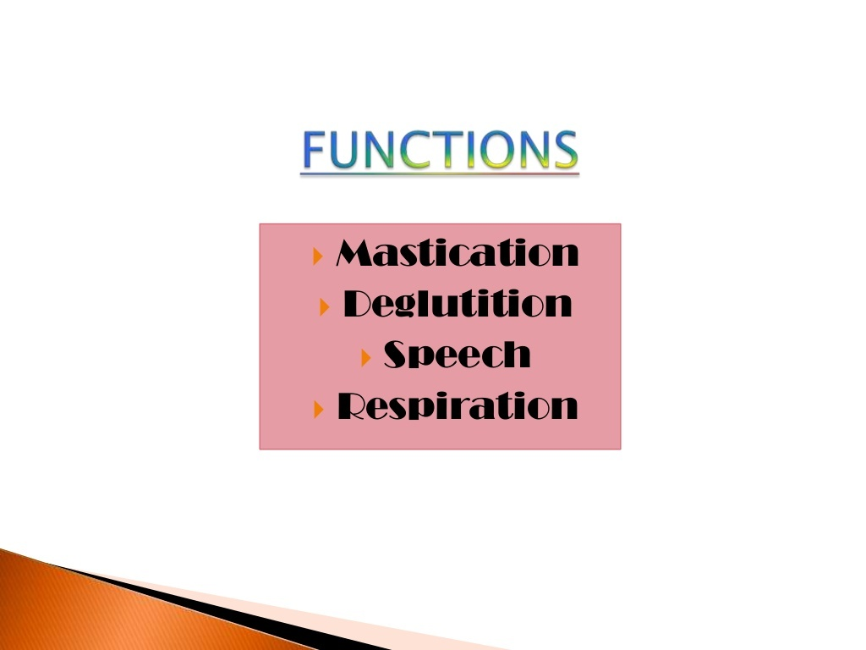

Slide 6


Slide 7
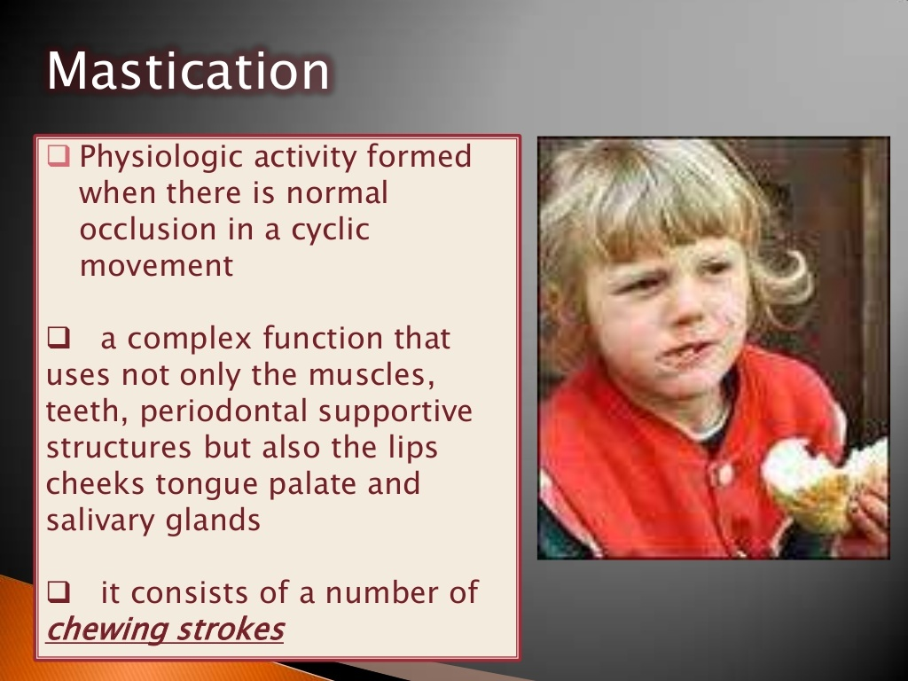

Slide 8
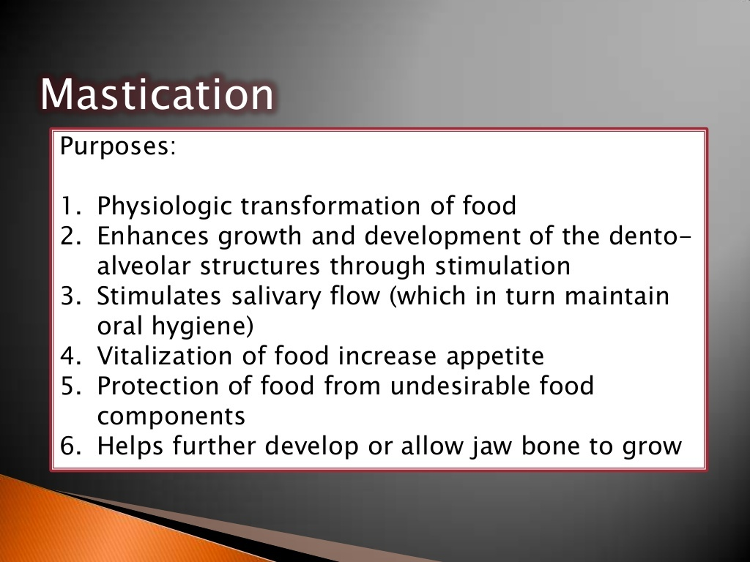

Slide 9
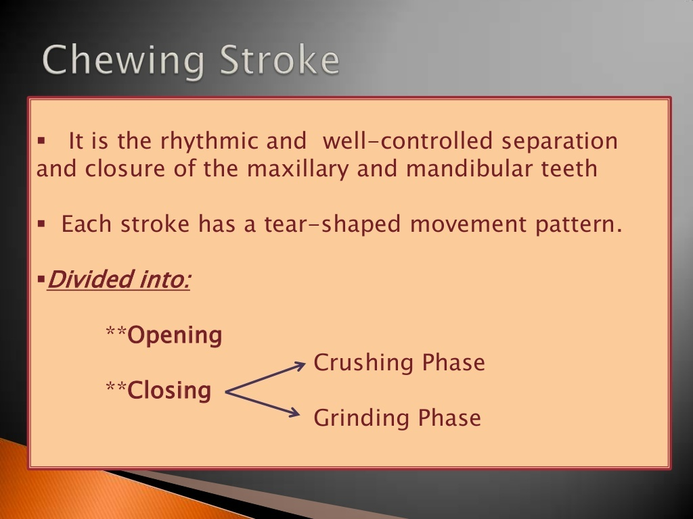

Slide 10
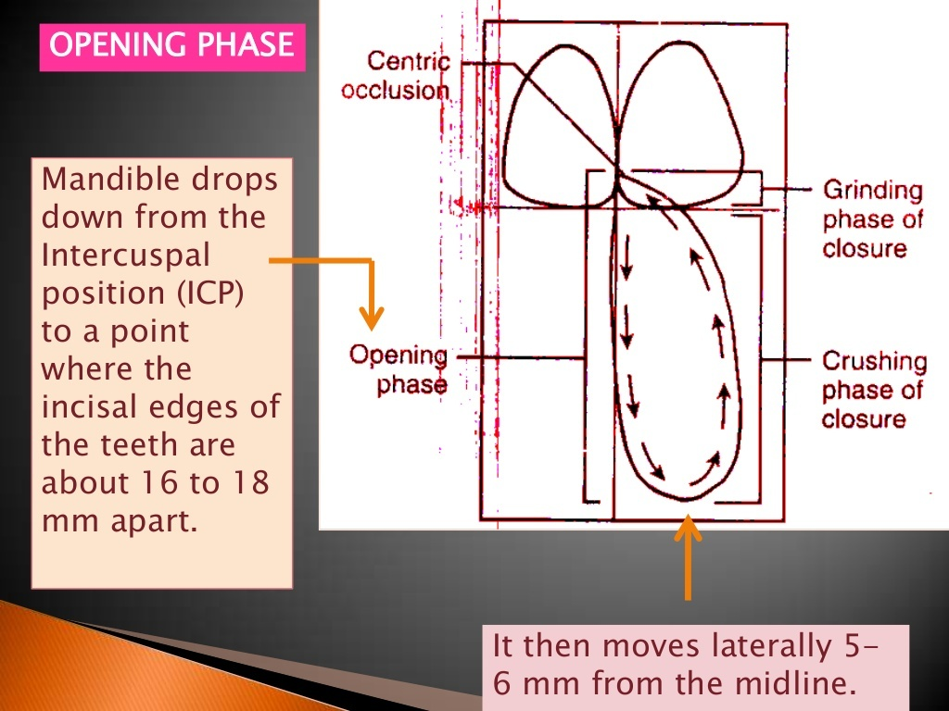

Slide 11
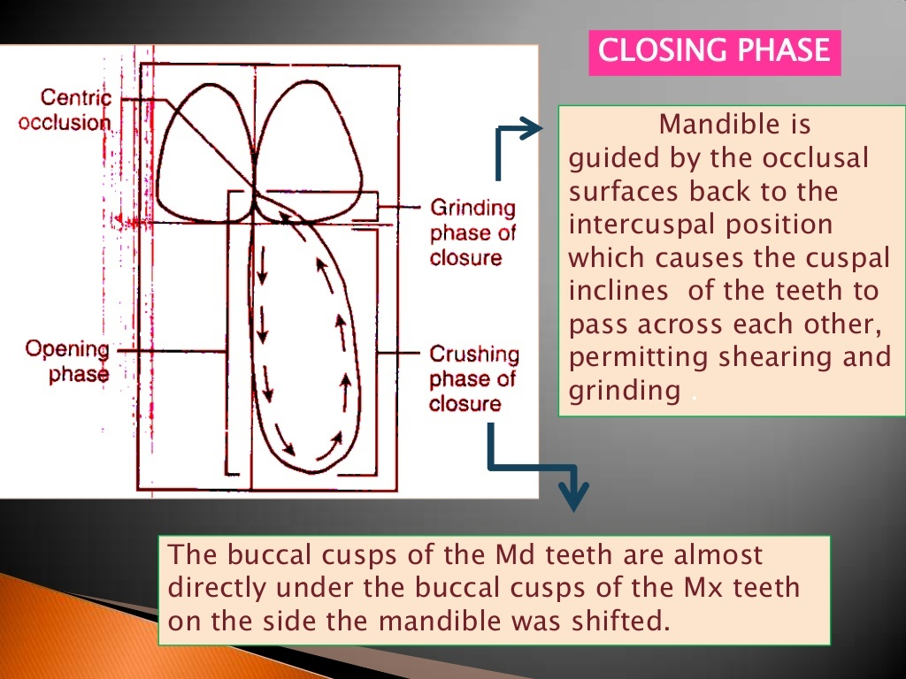

Slide 12
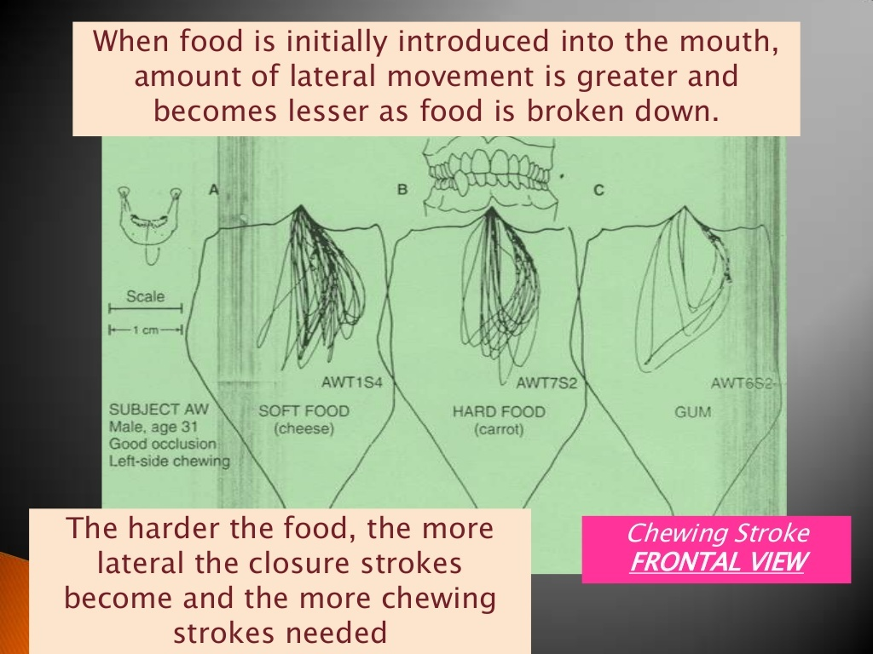

Slide 13
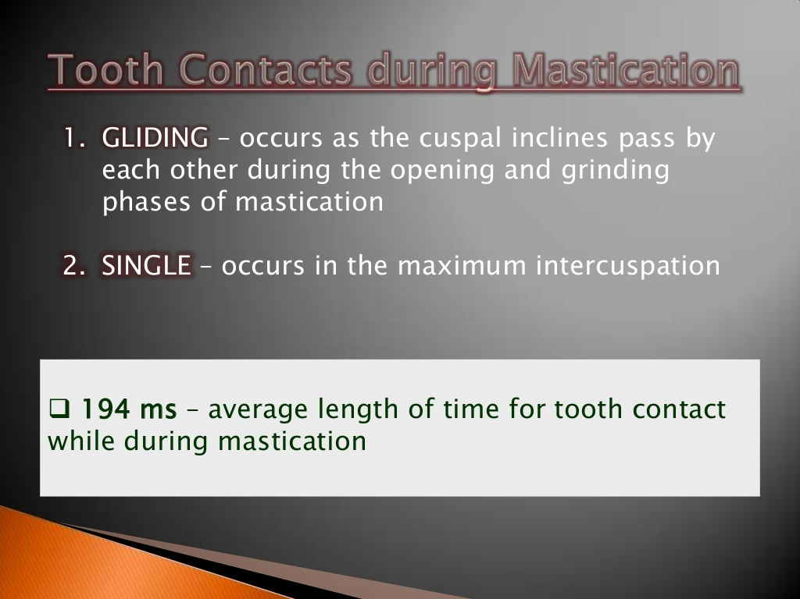

Slide 14
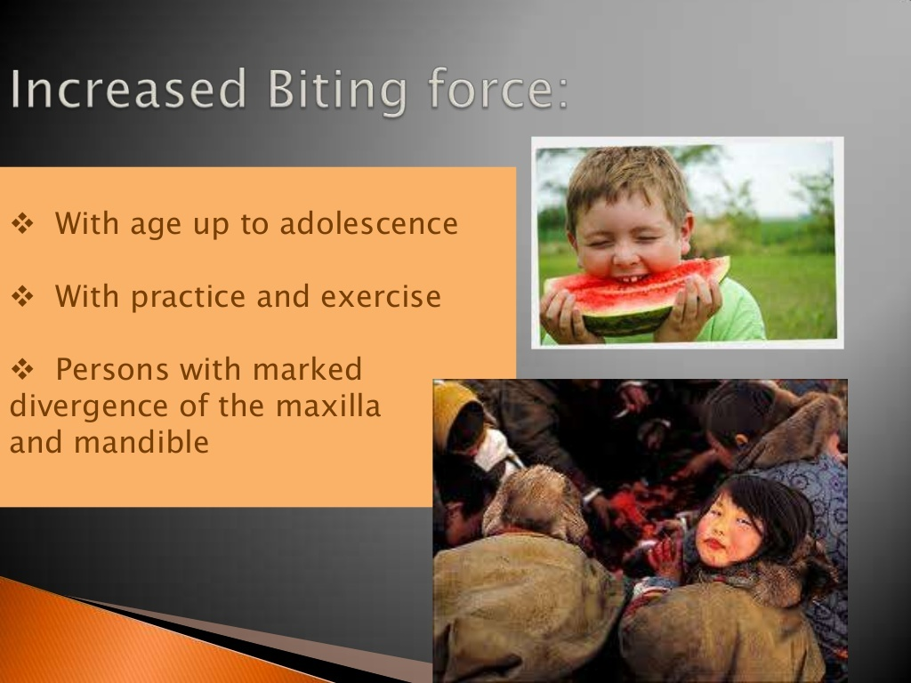

Slide 15
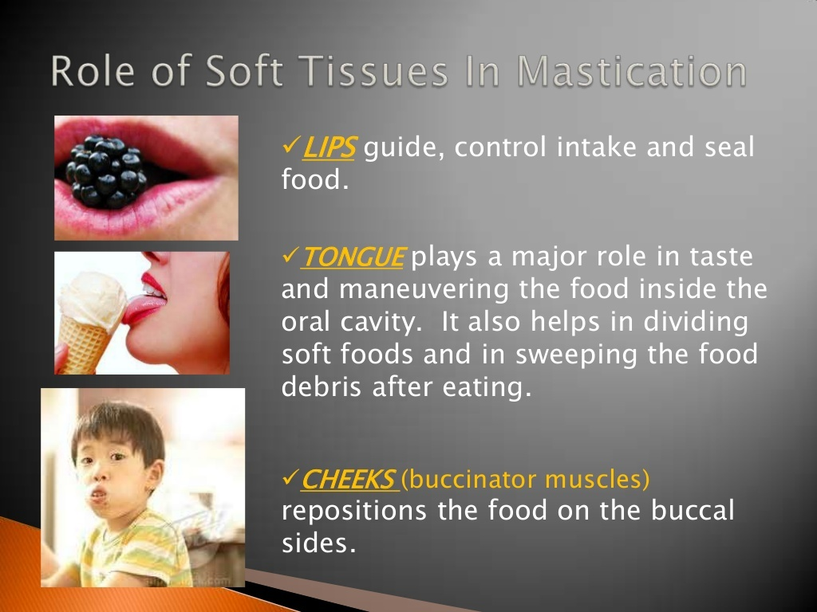

Slide 16
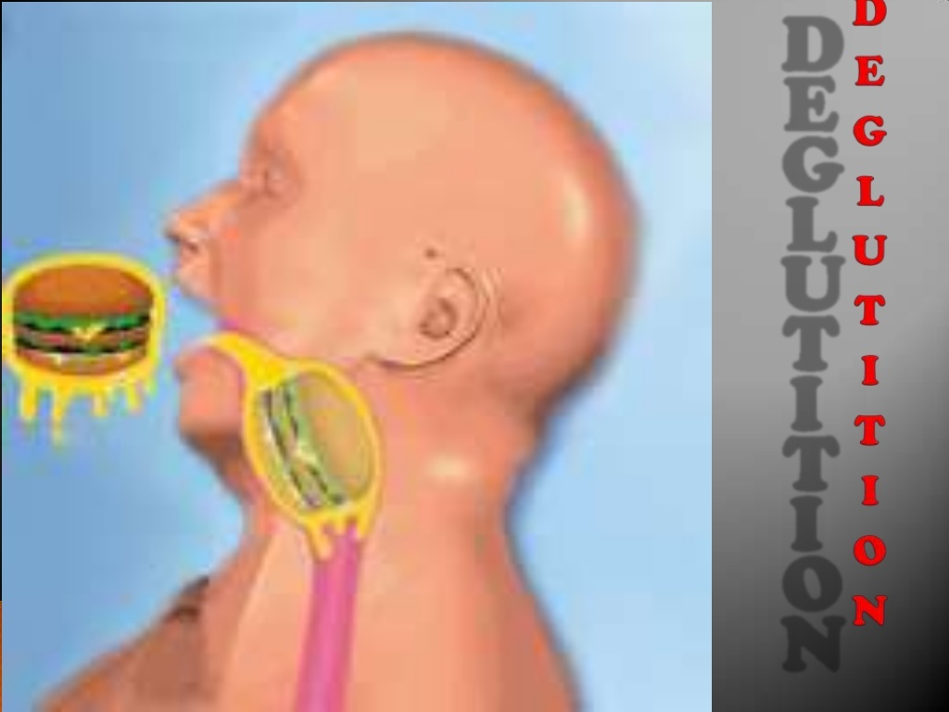

Slide 17
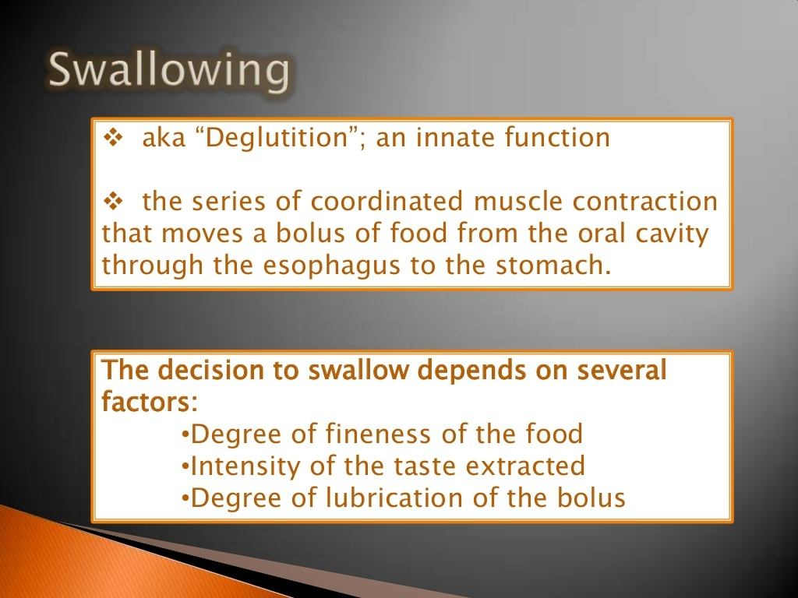

Slide 18
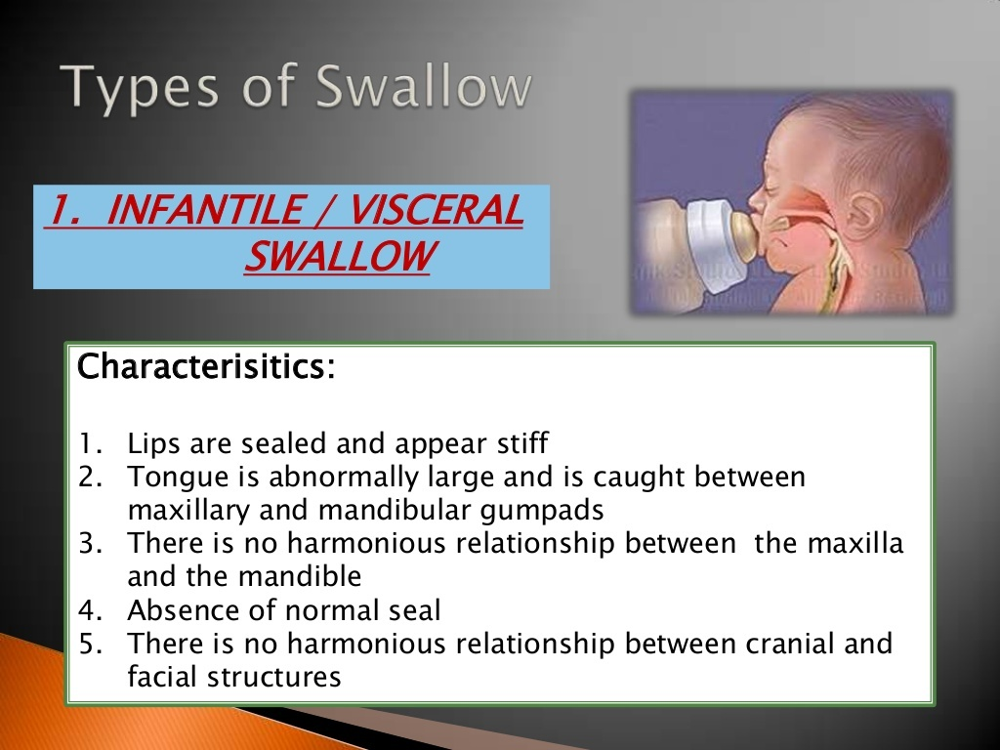

Slide 19
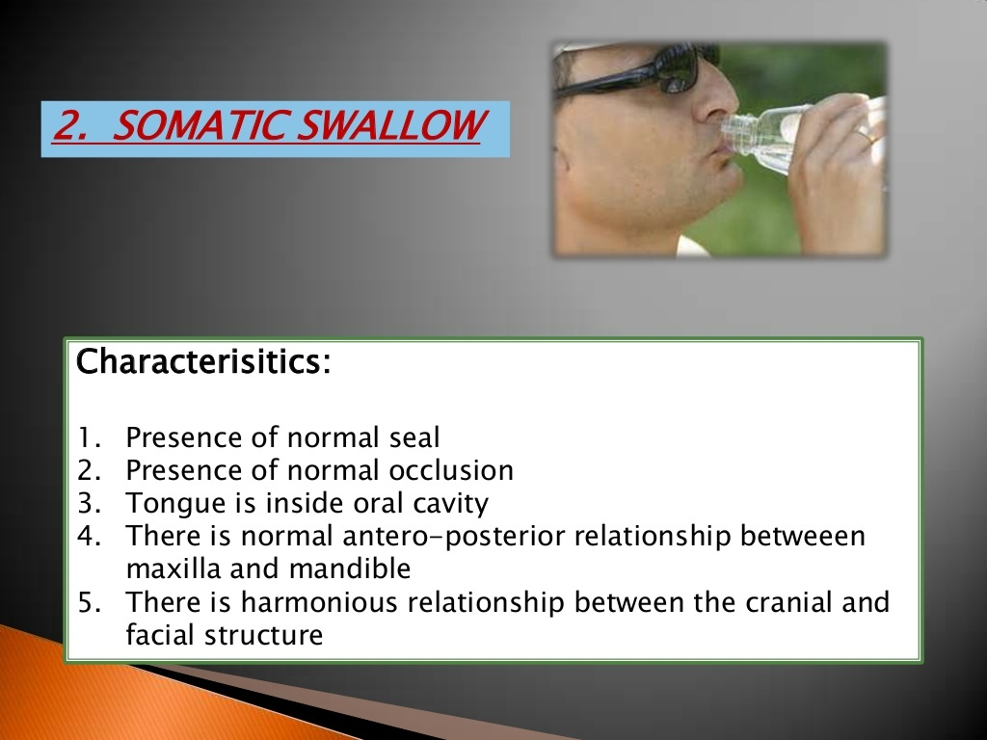

Slide 20
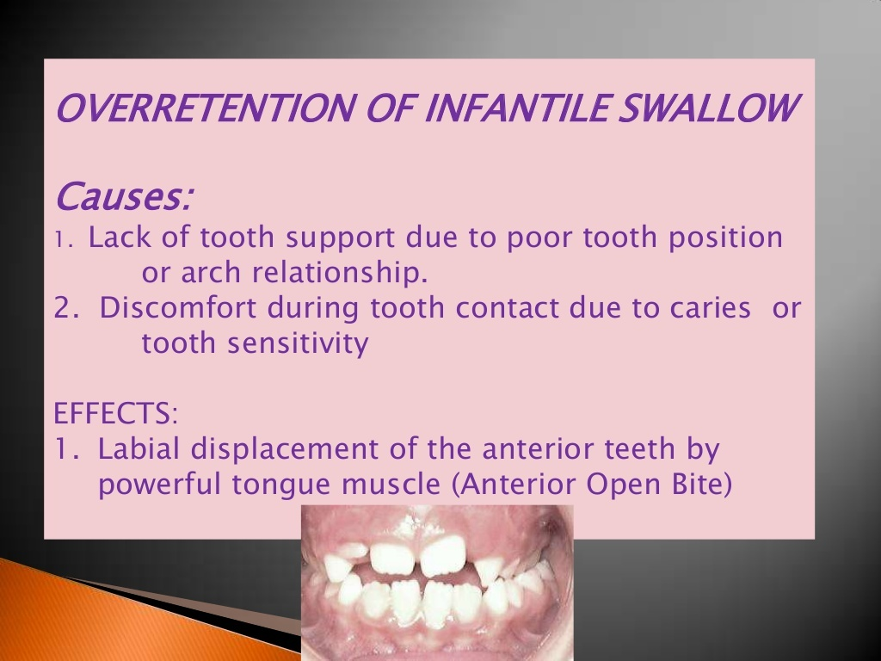

Slide 21
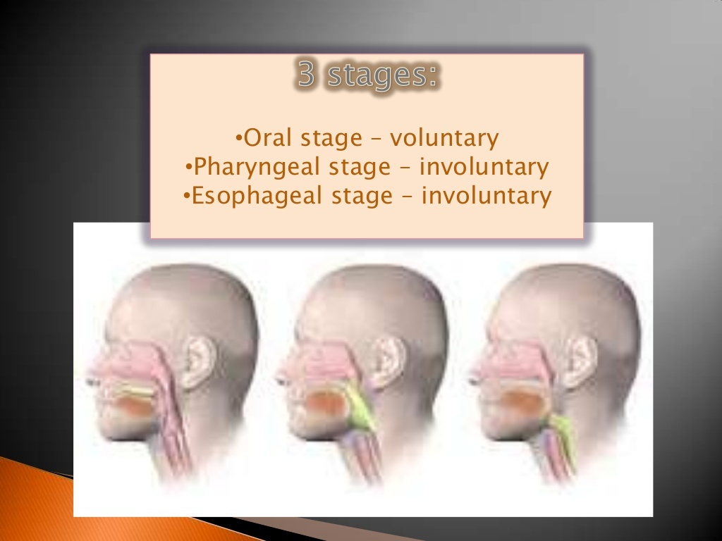

Slide 22
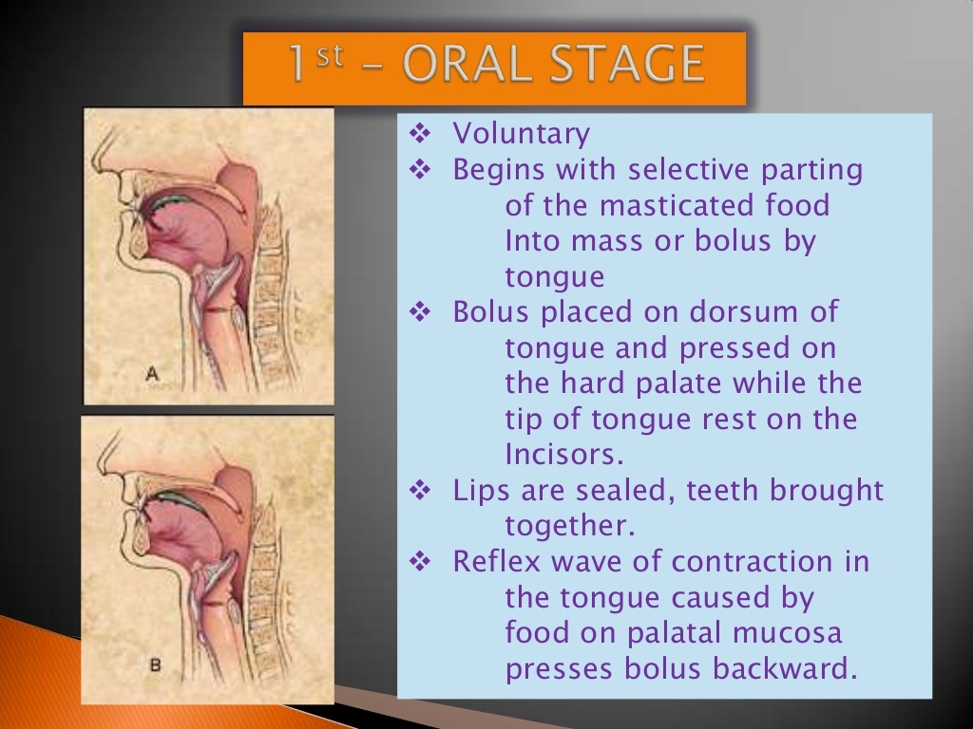

Slide 23
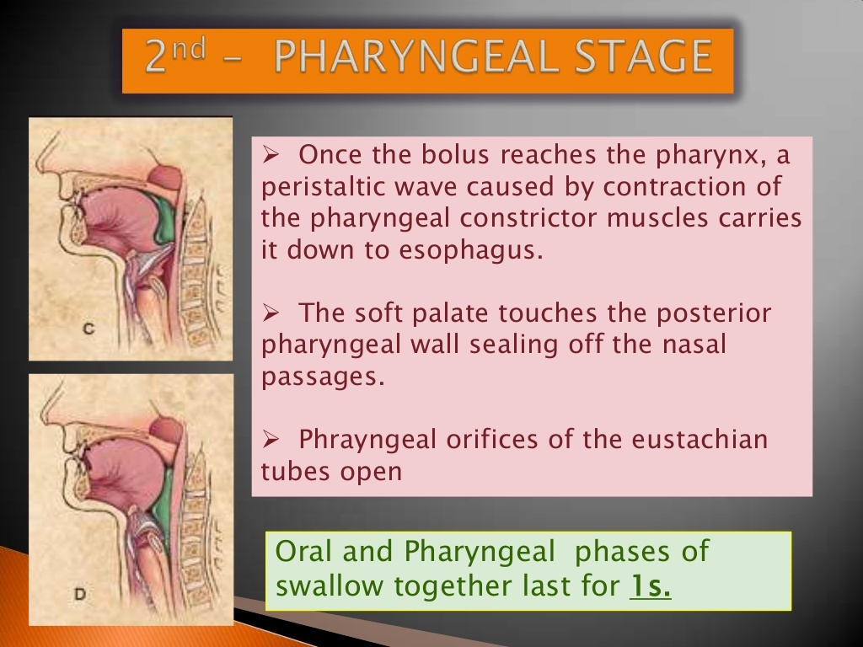

Slide 24
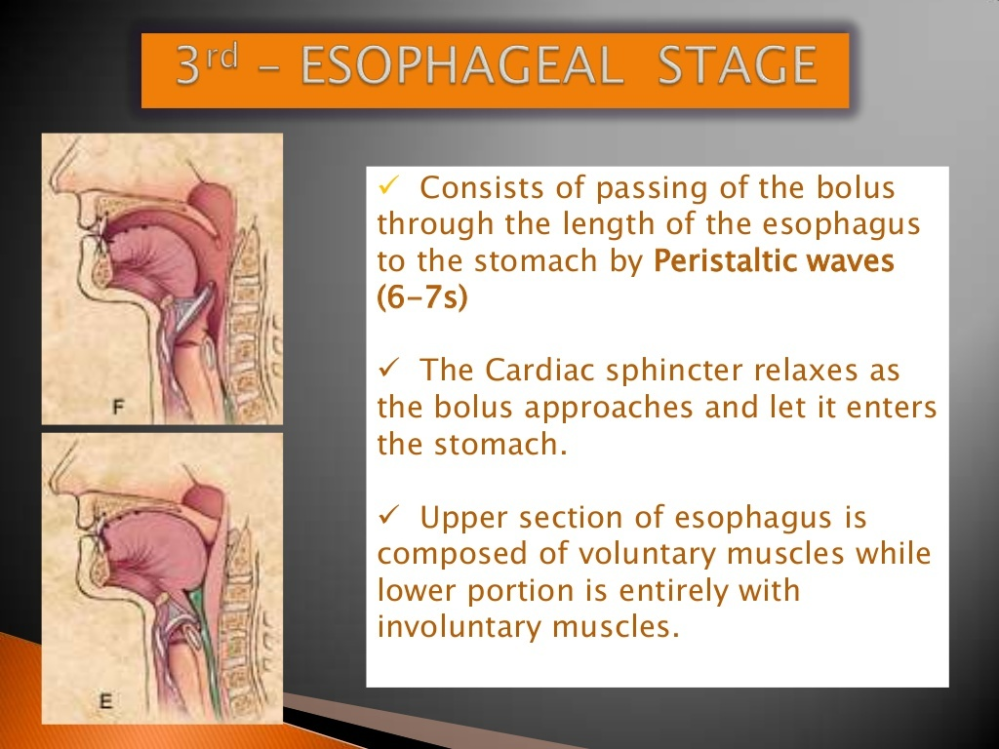

Slide 25
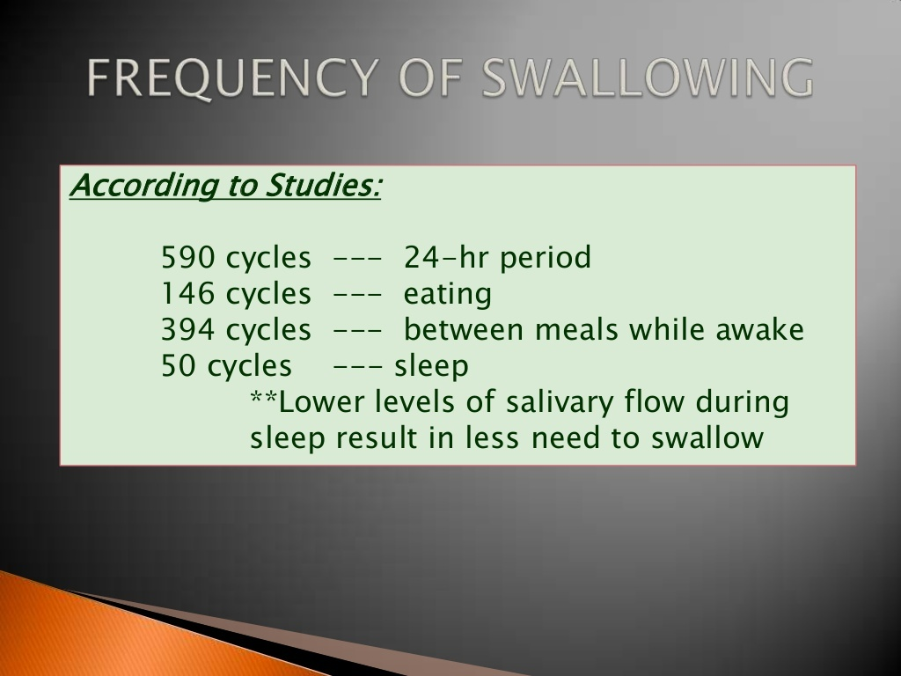

Slide 26
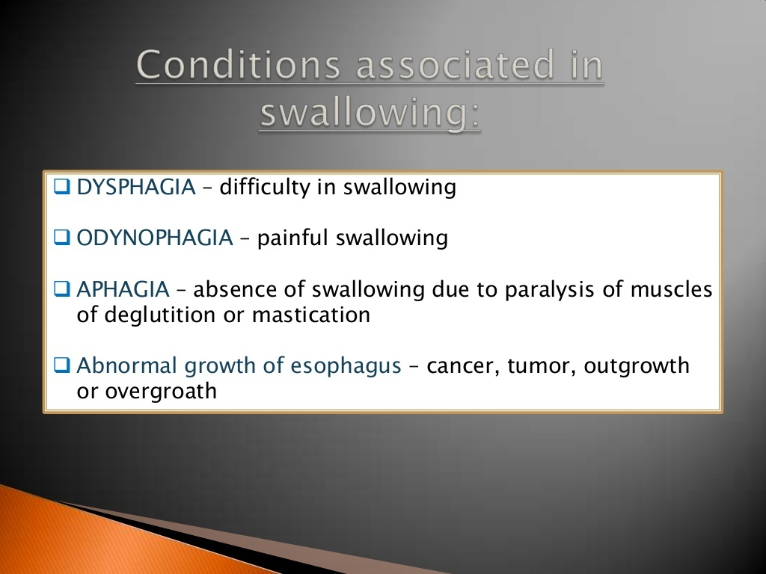

Slide 27
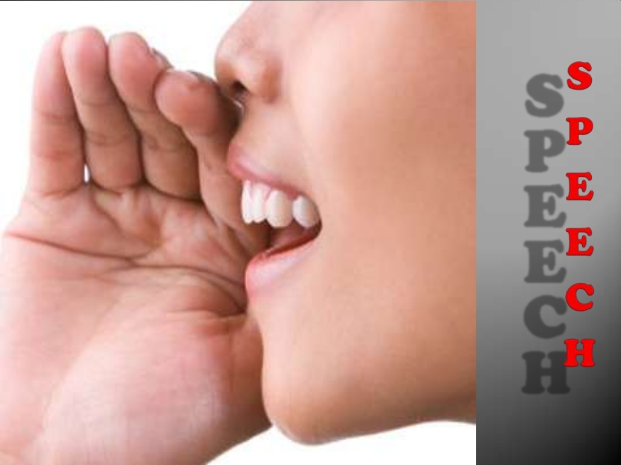

Slide 28
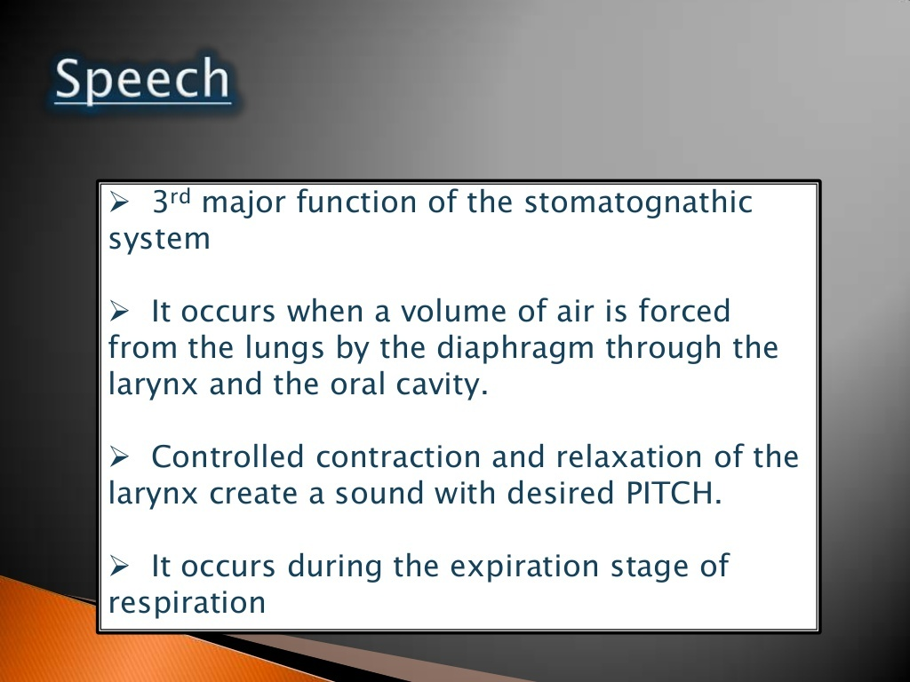

Slide 29
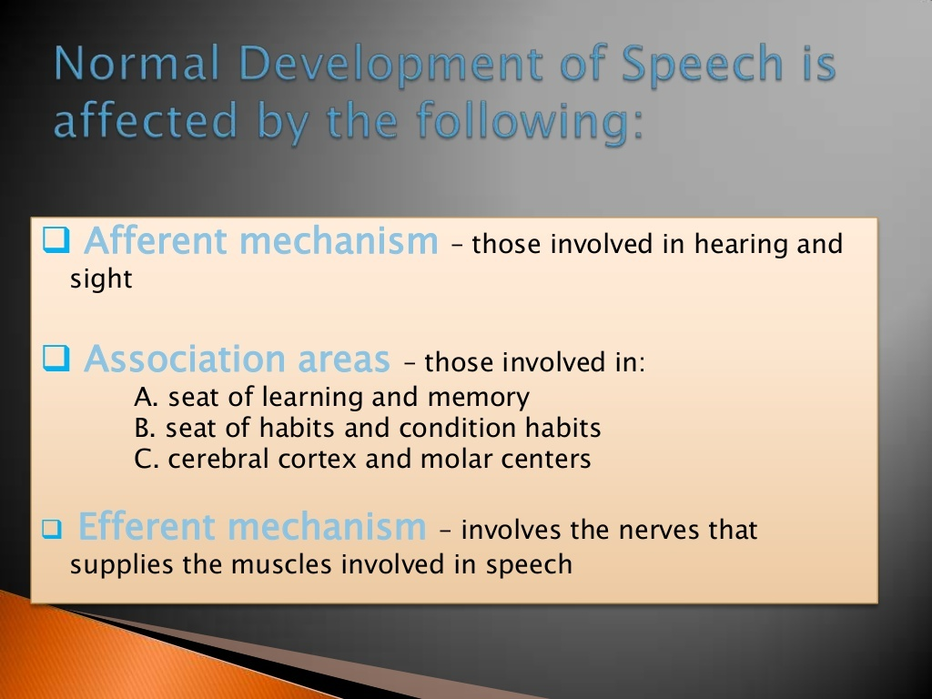

Slide 30
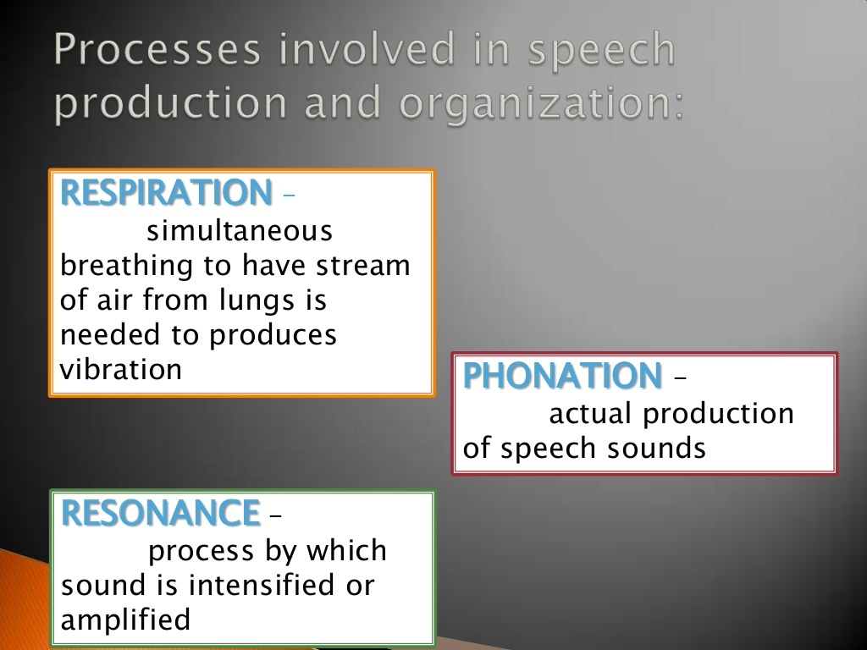

Slide 31
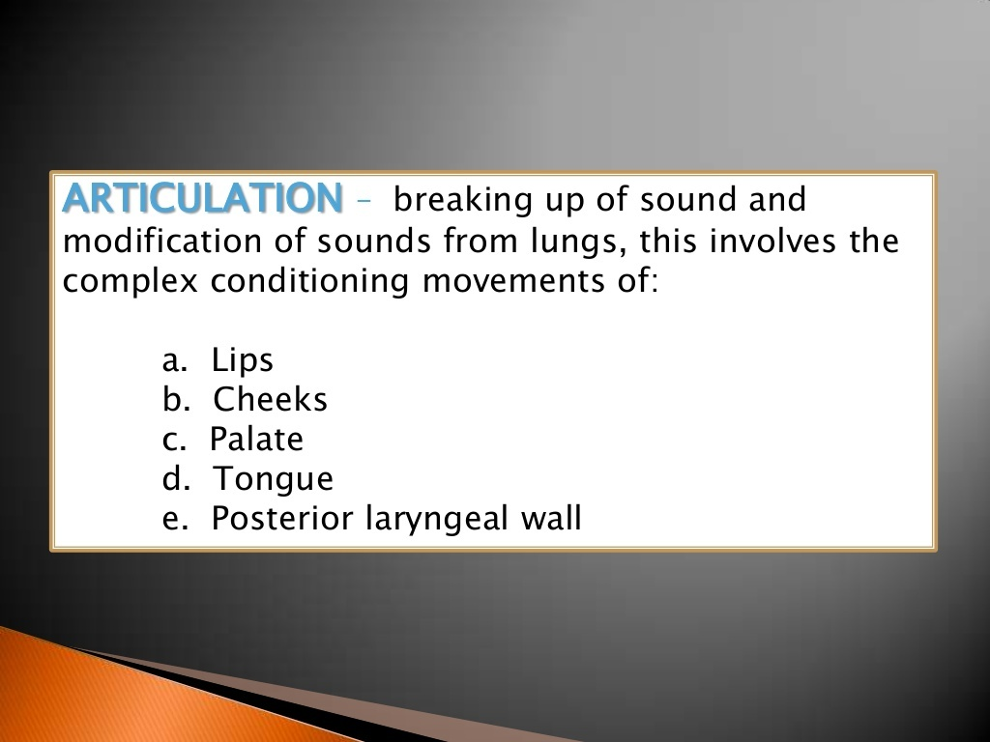

Slide 32
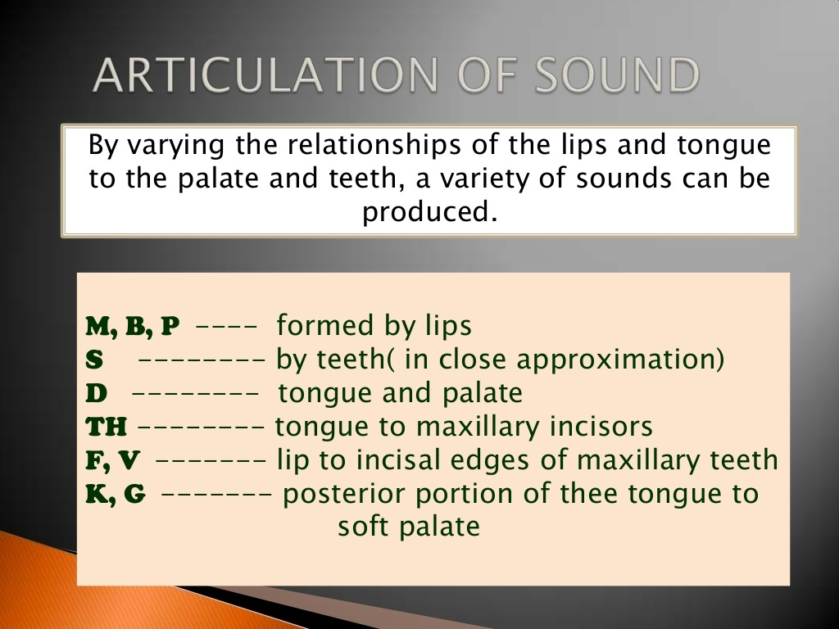

Slide 33
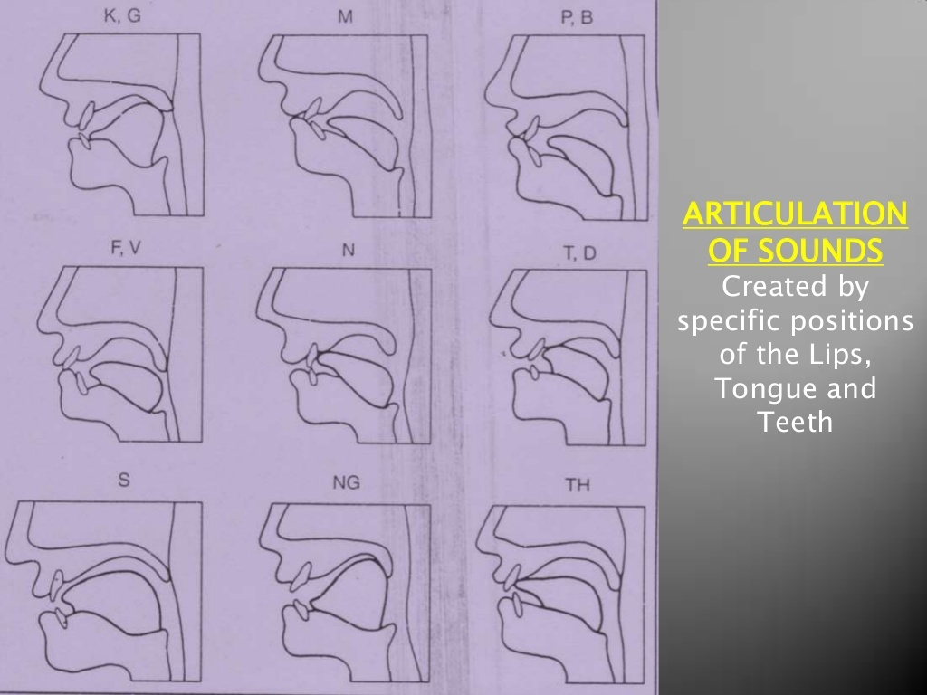

Slide 34
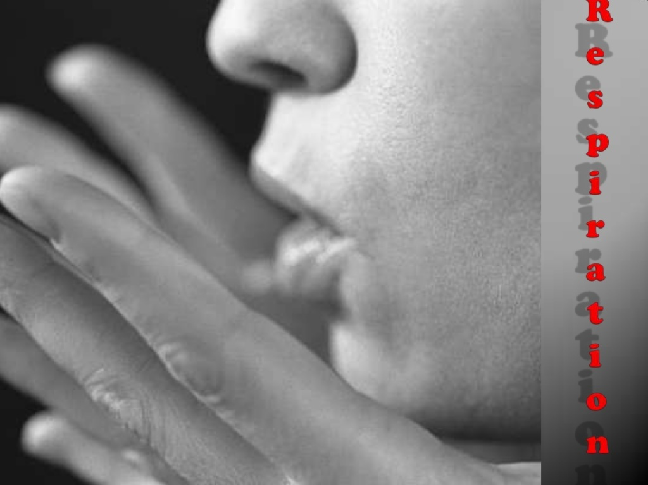

Slide 35
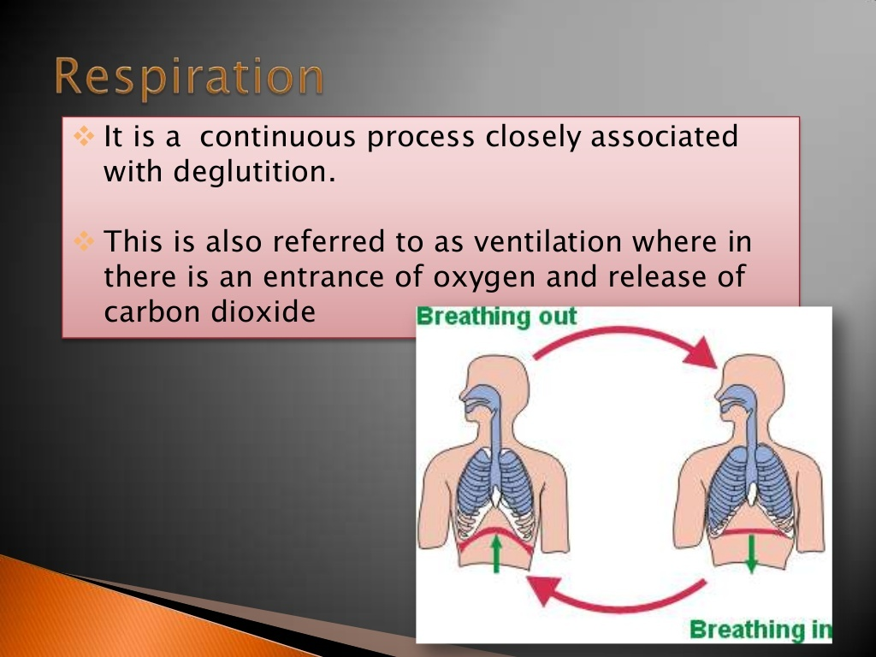

Slide 36
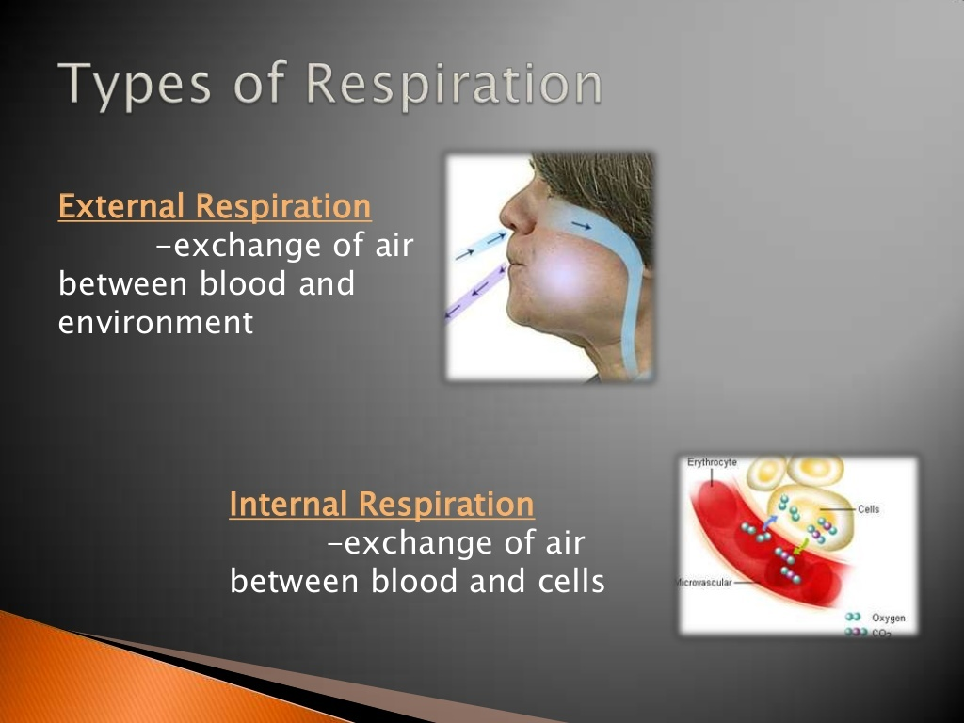

Slide 37
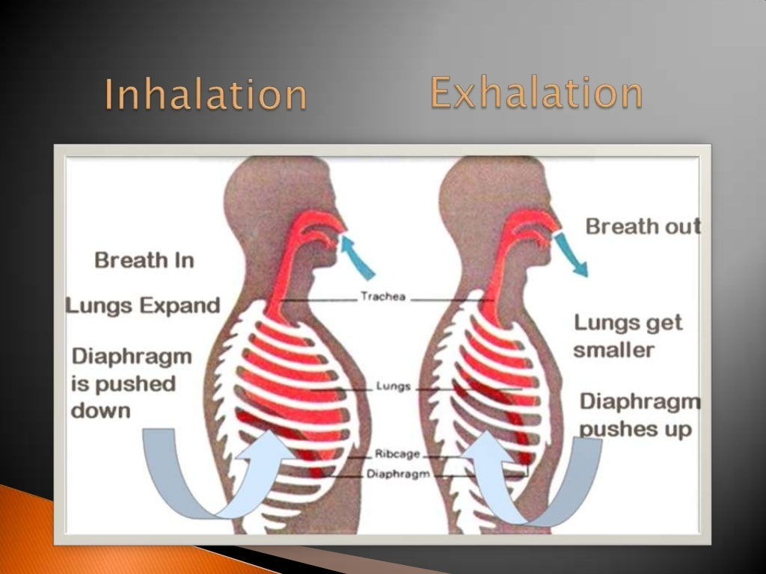

Slide 38
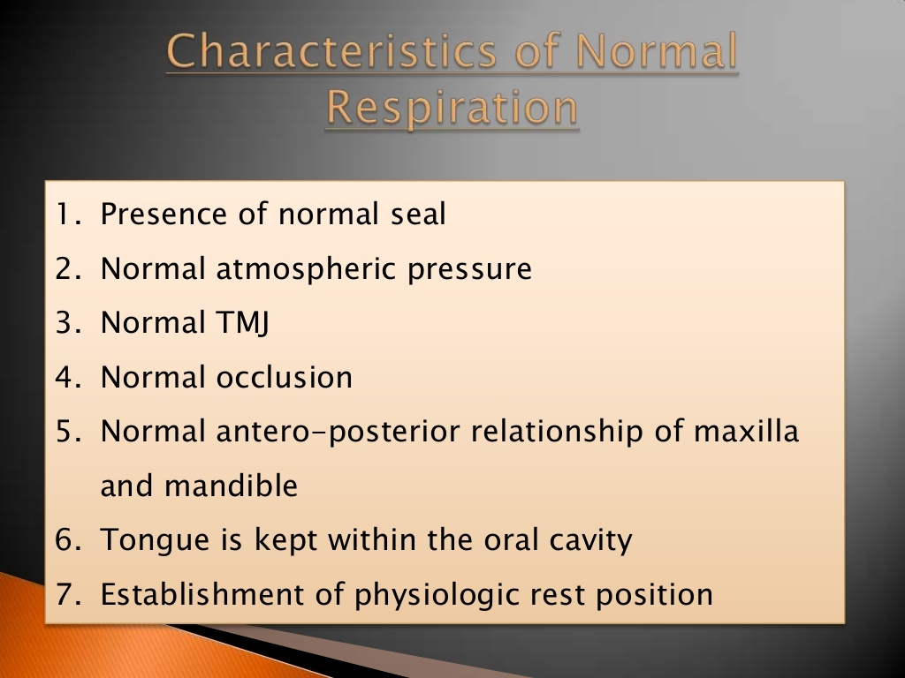

Slide 39
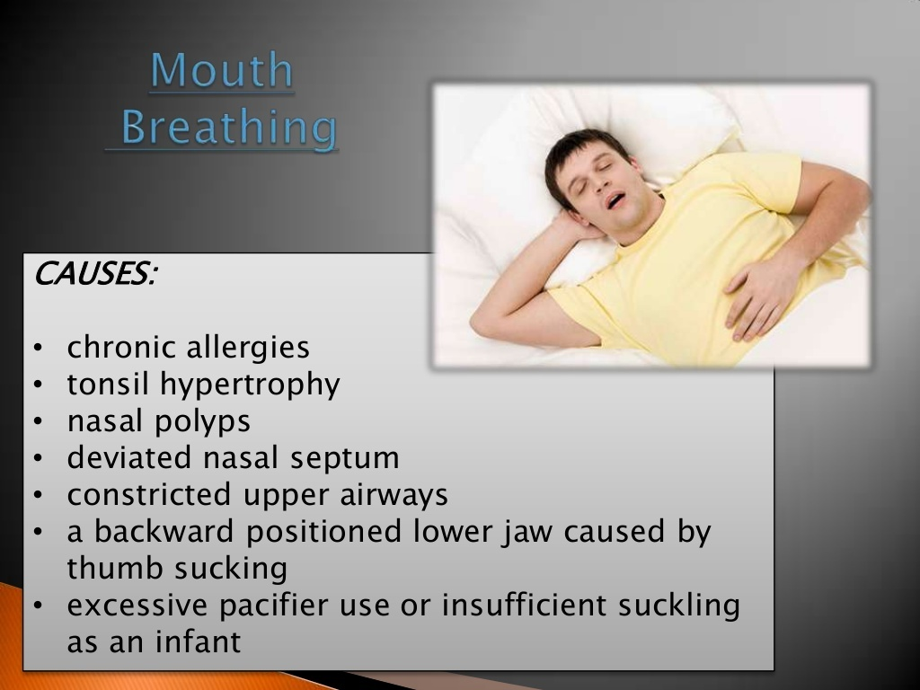

Slide 40
SUMMARY
Development of mature and complex orofacial functions progresses slowly yet meticulously through various age-related phases from infancy to adulthood.
In the formative years, infantile and altered
orofacial functions may remain for an unusually longer period, suchthat they become a habit.

Slide 41
REFERENCES
Textbook of Orthodontics – Gurkeerat Singh, Jaypee Brothers; 2nd Edition
Orthodontics – The Art and Science, S.I Bhalajhi, AryaMedi Publishing; 7th Edition
Textbook of Orthodontics – Sridhar Premkumar, Elsevier; 1st Edition
Orthodontics: Diagnosis and Management of Malocclusion and Dentofacial Deformities – O.P Kharbanda, Elsevier; 1st Edition

Slide 42
Question & Answer Session

Slide 43


